Slide 1
Town of Deerfield
Community Power
With Standard Power
April 5, 2023

Slide 2
What is Community Power?
Municipality bundles together residents and small businesses to procure electricity supply. Goals are cost savings and more renewable energy.

Slide 3
Existing utility services stay the same
If you participate:
Eversource and NHEC continue to handle billing, maintenance and emergency services. Eg. same crews respond to power outages
Electric assistance discount rates and budget billing are unaffected by program participation

Slide 4
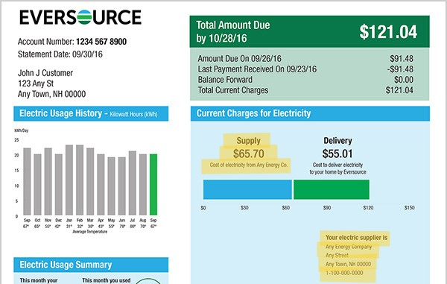

Slide 5
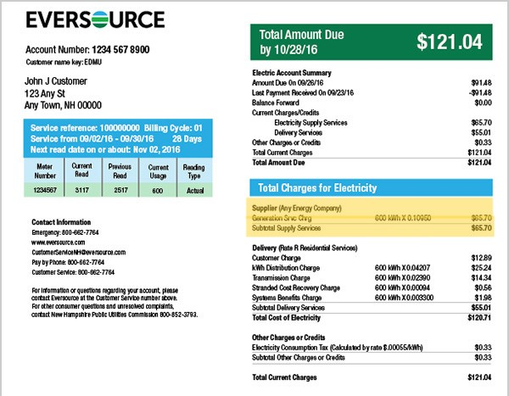

Slide 6
Competitive Pricing
Market Timing
Buying Power
+
By pooling demand across the entire municipality, we generate significant buying power. We can even team up with other municipalities.
Utilities have little flexibility on when to purchase power or how long to lock in. Community Power has complete flexibility.

Slide 7
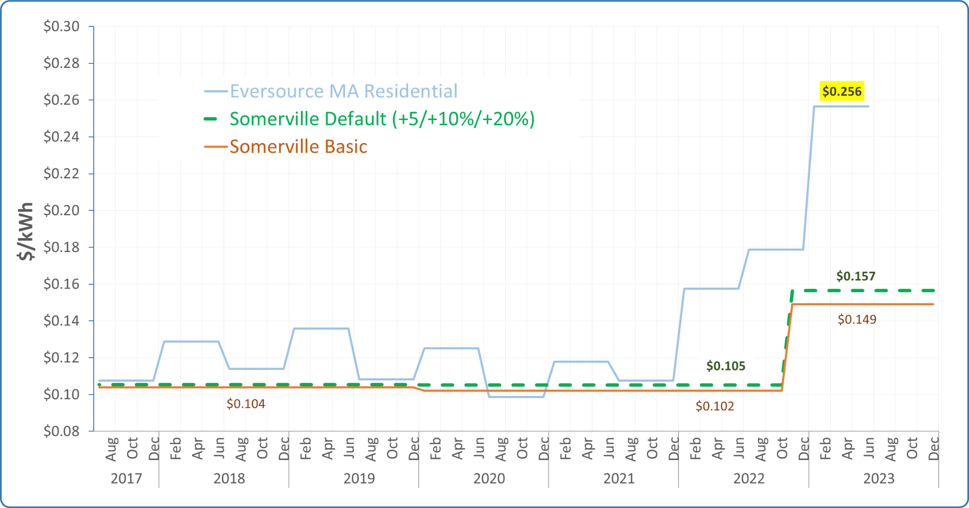
Example: Somerville Community Choice
Disclaimer: Savings cannot be guaranteed, because utility Basic Service prices change every six months for residential customers

Slide 8
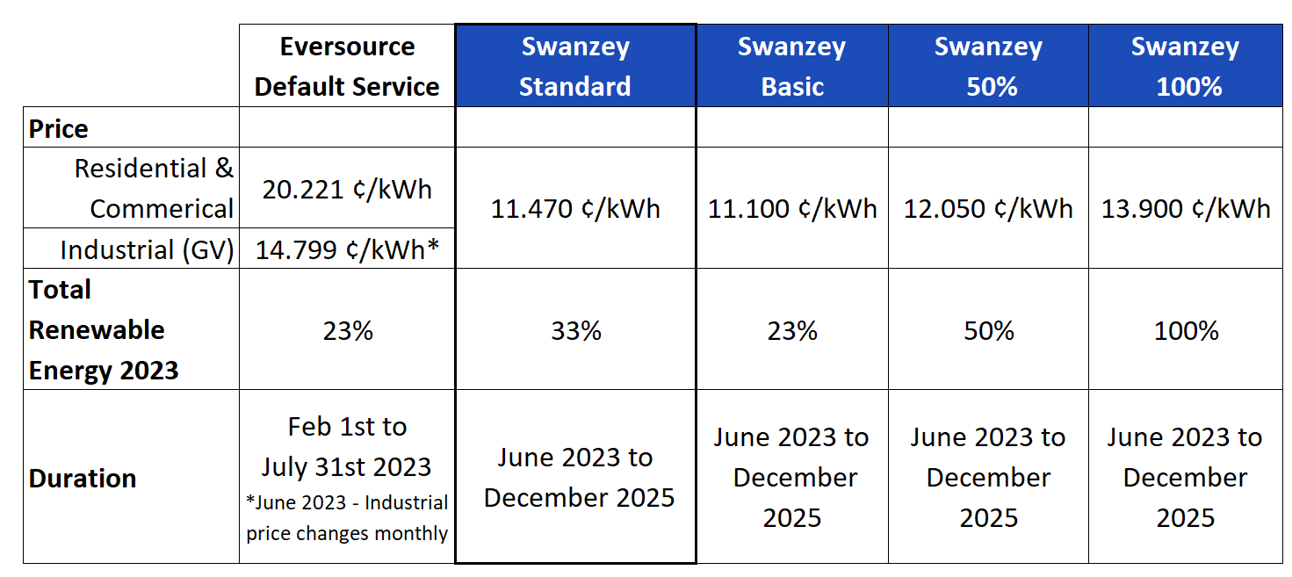
Example: Swanzey rates and terms

Slide 9
Stable & competitive, not “cheaper”
Savings compared to utility rate can’t be guaranteed, but…
Market Timing
Opportunity for advantageous pricing compared to utility
Term Length
Buying Power
Remember, you can always opt out without penalty.

Slide 10
Class I Renewables
Voluntary Renewables in this program are sourced from New England, New York and Eastern Canada, supporting the growth of renewable energy projects in our region.

Slide 12
Local Renewable Energy
Program choices and markets:
Green Default
Optional products
Optional program fund
Renewable Energy Certificates (RECs)
Local resources

Slide 13
More Benefits
Consumer protections
Local control
Energy planning
Innovative local programs
Education and awareness

Slide 14
Current Choices
Third Party Offers
Eversource Default Service
Community Power Program
Basic
New Program Default
50% renewable
100% renewable
Eligible customers are automatically enrolled in program default unless they opt out. Other customers can opt into the program.

Slide 15
Why we use an opt-out program
Critical for RFP Process
Brings the power of the competitive market to small customers
Provides high degree of certainty for supplier, reducing the rate impact of mitigating risk

Slide 16
Net Metering
Residential and small commercial customers
(as of April 2023)
System built before 2017? NEM 1.0/Standard customers keep their banked credits and continue to receive full kWh credit for their generation
System built after 2017? NEM 2.0/Alternative customers keep their banked credits but receive only partial dollar credit for their generation (transmission and distribution value only)
Customers eligible for a cash-out payment cannot do so while in the program
See informational handout or contact program for more details

Slide 17
Keep decisions and savings local
Write a plan
Get approval
Buy electricity
When you work with our team
Form CPC committee
Define goals
Plan: renewable energy integration
Plan: customer treatment
Plan: regulatory requirements
Community Feedback
Public Outreach
Public review process
Local approval
Community outreach
Public meetings
Public hearings
Regulatory submission
Regulatory Q&A
Regulatory approval
Engage suppliers to a new market
Supplier data
Supplier vetting
Market timing
Bidding
Contract negotiation
Choosing a supplier
Public outreach
Direct mail materials
Public meetings
Opt-out process
Customer Service
Ongoing program management

Slide 18
Timeline
Form Your Team
Plan & Approve
Regulatory
Outreach + launch
Manage + Monitor
Draft Community Power Plan with public input
Secure local approval of plan (Select Board and Town Meeting)
Submit Plan to Public Utilities Commission for approval. This approval step can be initiated prior to approval at Town meeting
Procure electricity supply
Implement public education and opt-out campaign
Launch! Eligible accounts that have not opted out are automatically enrolled
Appoint a Community Power Committee
Choose experienced SP/GE to help plan and launch your program
Provide ongoing customer support, outreach, opt up campaigns, data management and analysis, planning, and more

Slide 19
Standard Power Inc.
Teamed up with Good Energy LLP in 2020
Providence and six communities in RI launching in May, representing 20% of state load
45 programs in Massachusetts, representing 400 million kWh/year
City of Keene and 11 NH Towns
First four programs in NH launching in June
Buying groups for 2023 and 2024

Slide 20
Questions?
Emily Manns
Community Power Consultant
Standard Power e.manns@standardpower.com
Ryan Polson
Senior Energy Consultant
Standard Power r.polson@standardpower.com
Theresa MacDowell
Energy Consultant
Standard Power t.macdowell@standardpower.com
https://www.standardpower.com/

